Slide 1
Crime Risk New Use Case for an Existing Model
Model Review Committee Documentation
09/03/2025
*Refer to Best practices for naming Models in the Appendix

Slide 2
Agenda
01 Model Business Case
Model Use Case
Product Use Case
<Model Name>
02 Model Data Preparation
Model Data Sources (Input)
Model Data Elements
03 Model Development
Model Framework
Model Outputs
04 Model Validation
Model Performance & Validation
Model Surveillance

Slide 3
Model Business Case
01
CrimeRisk

Slide 4
Model Business Case
Crime Risk
Model Use Case
Establish crime risk at the Census Block Group, Block, and Address level for all U.S. locations
New Use Case:
Existing uses have been carried-over since Location, Inc. acquisition in 2020
This is the first MRC documentation of Crime Risk
Product Use Case
Crime Risk scores for insurance use :
Crime risk scores help insurance companies evaluate the likelihood of insurance claims in specific areas, impacting premium pricing.
via RiskMeter online reports and Spatial API
Direct Product Revenue 2024: $ 5,704,716
SecurityGauge and NeighorhoodScout crime analytics for non-insurance uses :
Companies evaluate security needs at a site
via SecurityGauge and NeighborhoodScout online reports, SDAP bulk product
Direct Product Revenue 2024: $ 763,432 (SG online reports only)

Slide 5
Model Data Preparation
02
CrimeRisk

Slide 6
Model Data Sources (input)
CrimeRisk predictors pt. I
Variable Name | Variable Definition | Data Source | Variable Lift (t-stat)
ENCENTRAL | East North Central region of U.S. (1=within, 0=outside) | Census geographic relationship files | -17.486
MIDATLANTIC | Mid Atlantic region of U.S. (1=within, 0=outside) | Census geographic relationship files | -21.769
SOUTHATLANTIC | South Atlantic region of U.S. (1=within, 0=outside) | Census geographic relationship files | -8.232
ZCITY_CENTERS_DIST | Distance from central business district, standardized | Census geographic relationship files | -8.697
ZCOL_PCT | Pct. Population currently enolled in college, standardized | American Community Suvey (Census) | -15.107
ZDET_PCT | Pct. housing units in single family detached houses, standardized | American Community Suvey (Census) | 13.671
ZGINI_INDEX | Gini index of inequality, standardized | American Community Suvey (Census) | 9.312
ZIN_HOUSEHOLD_PCT | Pct. population in households (not group quarters) , standardized | American Community Suvey (Census) | 13.491
ZLG10_DORMS_PCT | Pct. population living in college dorms, log transformed and standardized | American Community Suvey (Census) | 12.275
ZLG10_GRANDKIDS_PCT | Pct. of children living with grandparent not parent, log transformed and standardized | American Community Suvey (Census) | 10.888
ZLG10_JOB_DENSITY | Density of jobs per square mile, log transformed and standardized | Longitudinal Employer-Household Dynamics (Census) | 7.538
ZLG10_JOBS_1MI | Total jobs within 1 mile radius, log transformed and standardized | Longitudinal Employer-Household Dynamics (Census) | 10.016
Model Inputs:

Slide 7
Model Data Sources (input)
CrimeRisk predictors pt. II
Variable Name | Variable Definition | Data Source | Variable Lift (t-stat)
ZLG10_POPULATION_5MI | Total population within 5 mile radius, log transformed and standardized | Annual Population Estimates (Census) | 14.561
ZMARRIED_PCT | Pct. households containing married couple, standardized | American Community Suvey (Census) | -11.489
ZMRPCT_VAL_RM | Average home value per room relative to metro area, standardized | American Community Suvey (Census) | -10.885
ZNONFAM_PCT | Pct. households classified as non-family, standardized | American Community Suvey (Census) | 13.991
ZSQRT_MD_RETAX | Median real estate tax paid, square root transformed and standardized | American Community Suvey (Census) | -10.106
ZSQRT_MOVED1YR_PCT | Pct. households moving in past yearsquare root transformed and standardized | American Community Suvey (Census) | 12.721
ZSQRT_SINGLEPARENT_PCT | Pct. households with unmarried parent and one or more child, square root transformed and standardized | American Community Suvey (Census) | 19.091
ZSQRT_UNEMP_PCT | Pct. of workforce unemployed, square root transformed and standardized | American Community Suvey (Census) | 9.827
ZSQRT_VACANT_PCT | Pct. housing units vacant, square root transformed and standardized | American Community Suvey (Census) | 16.4
ZUSRPCT_TOTAL_SC | Nationally comparable school quality index, standardized | National Center for Educational Statistics | -12.851
Model Inputs:

Slide 8
Model Development
03
CrimeRisk

Slide 9
Model Framework
Crime Risk
Step 1: Establishment of agency level crime rates, and weighted total rate
Proprietary relational database
Associate crime incidences from 18,000+ local law enforcement agencies in the U.S. to the specific local communities the agency covers.
Input crime data
Most recent 'Final, Non-Preliminary' data available as classified by the FBI.
Complete national coverage of reporting agencies.
Interpolated crime rates
In cases where agencies fail to report annual crime rates, interpolate from prior year reporting.
Interpolated crime rates are increased or decreased from prior years in proportion to changes at the state level.
Weighted Total Rate
Crime rates for seven specific crime types are combined into a total crime rate, weighted by the severity of each crime.
Severity is assumed to be inversely proportional to national crime rate per thousand residents of each crime type. The specific crimes included are homicide, rape, armed robbery, aggravated assault, burglary, larceny, and motor vehicle theft.
Normalizes the local rate to the expected national rate for each of the seven types of crime, and divides by 7, weighting the relative risk of each crime type equally.

Slide 10
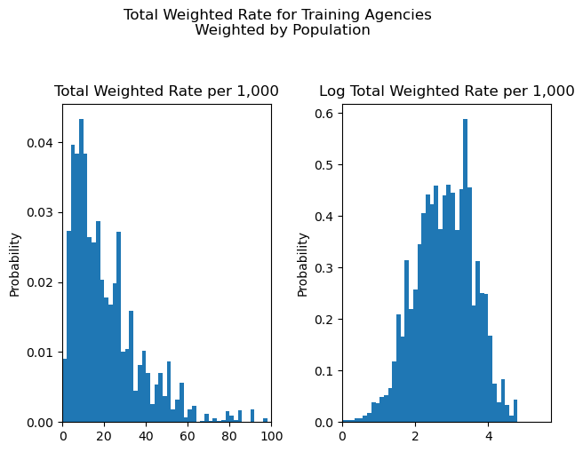
Model Framework
Crime Risk
Step 2: Linear regression risk model prediction for Census Block Groups
Target Variable: Weighted Total Crime Rate (see previous slide)
Log transformation used in model

Slide 11
Model Framework
Crime Risk
Step 2: Linear regression risk model prediction for Census Block Groups
Target Variable: Weighted Total Crime Rate (see previous slide)
Block Group Level Estimation:
Linear risk model used to down-scale crime risk from police agency to US Census Block Group level
Block Group level predicted total crime rates are adjusted so the population-weighted average crime rate is equal to the agency level crime rate from step 1 above.
Original Model Development:
Trained on 2016 agency level crime reporting
Original list of predictors created from literature review and limited to exclude information on race, ethnicity, language, gender, occupation and income level¹
Variables operationalized from this list were included in a stepwise selection algorithm to create the baseline model.
Data transformations (e.g. log) to meet normality assumption
Annual Model Update:
Input data is refreshed annually and processed using a stable set of model coefficients.
No annual model retraining occurs unless requested
2025 Model Retrain:
Removal of four variables as requested by Governance
Addition of four replacement variables
Ridge Regression estimation to reduce overfitting
80/20 Train/Test split
Trained on 2024 agency level crime reporting
Notes:
1. Income level is excluded but income inequality is included.

Slide 12
Model Data Sources (input)
CrimeRisk predictors flagged for removal and proposed additions
Variable Name | Variable Definition | Data Source | Action
ZLG10_GRANDKIDS_PCT | Pct. of children living with grandparent not parent, log transformed and standardized | American Community Suvey (Census) | REMOVE
ZMARRIED_PCT | Pct. households containing married couple, standardized | American Community Suvey (Census) | REMOVE
ZSQRT_SINGLEPARENT_PCT | Pct. households with unmarried parent and one or more child, square root transformed and standardized | American Community Suvey (Census) | REMOVE
ZNONFAM_PCT | Pct. households classified as non-family, standardized | American Community Suvey (Census) | REMOVE
ZLG10_POP_CH_1MILE | Population change within 1 mile radius, over 5 years, log transformed and standardized | Annual Population Estimates (Census) | ADD
ZLG10_SEASONAL_PCT | Pct. housing units vacant and seasonally occupied, log transformed and standardized | American Community Suvey (Census) | ADD
ZSQRT_JOBS_45MIN | Employees working within 45 minute drive distance, square root transformed and standardized | Longitudinal Employer-Household Dynamics (Census) | ADD
ZSQRT_POP_EST_50MILE | Total population within 50 mile radius, square root transformed and standardized | Annual Population Estimates (Census) | ADD
Model Inputs:
Added variables have same themes and sources as existing variables reviewed by Legal / Governance:
ZLG10_POPULATION_5MI, ZSQRT_VACANT_PCT, ZLG10_JOBS_1MI, ZSQRT_MOVED1YR_PCT

Slide 13
Model Performance & Validation(Pre-Production)
CrimeRisk
Model Validation Approach
All models evaluated against 2024 agency level crime reporting
Universe: 10,973 agencies with at least 1,000 population
Target: Total crime rate weighted by agency population and crime severity
Performance Results
Model versions R-squared comparison
 | Existing model (2016 training) | Retrain and Remove 4 Features | Retrain and Replace 4 Features
2024 Training Set (n=9,580) | 0.613 | 0.589 | 0.648
2024 Testing Set (n=3,194) | 0.630 | 0.635 | 0.685
Model versions mean absolute error (MAE) comparison
 | Existing model (2016 training) | Retrain and Remove 4 Features | Retrain and Replace 4 Features
2024 Training Set (n=9,580) | 7.285 | 7.099 | 6.573
2024 Testing Set (n=3,194) | 7.075 | 6.771 | 6.376
*Refer to the Model Validation Guidance in the Appendix for more details.

Slide 14
Model Framework
Crime Risk
Step 3: Calculation of rates within the vicinity of a Census Block or Address
High resolution crime rate estimates for over 8 million Census Blocks
Spatially interpolated from the Census Block Group level crime rates established with linear model.
Block level crime rates are generated based on a distance-weighted cone of influence.
Crime rate calculation is weighted most heavily nearest the block and lessens as it progresses outward, depending on distance and population.
Address-level interpolation used on SecurityGauge follows the same logic.
Cone of influence is divided into three rings.
Inner Ring - The crime risk calculation is weighted most heavily within the Inner Ring, nearest the block. It has a radius ranging from as little as 300 feet up to a maximum of 2,700 feet, based on population density directly around the location.
Middle Ring - The middle ring's crime risk is weighted moderately and has a maximum radius of 1 mile or a population threshold of 25,000 people.
Outer Ring - The outer ring's crime risk calculation is weighted the least. It has a maximum radius of 3 miles or a population threshold of 100,000 people.

Slide 15
Model Framework
Crime Risk
Step 4: Indexing of local crime rates to the total crime risk score
In the final step, Census Block level crime rates are indexed to the national average and scaled from 0-100.
Total Crime Risk (RiskMeter, Spatial API) is calculated as:
20 * Block Level Weighted Total Crime Rate / National Level Weighted Total Crime Rate
Multiplying by 20 provides an index where 20 = the national average
40 is twice the national average, and 10 is half the national average.
The final crime risk score output is an index capped at 100 where 100 equals 5 times the average crime risk nationwide.
Total Risk (SecurityGauge) is calculated as:
100 * Address Level Weighted Total Crime Rate / National Level Weighted Total Crime Rate
Multiplying by 100 provides an index where 100 = the national average
200 is twice the national average, and 50 is half the national average.
The final crime risk score output is an index capped at 5000 where 5000 equals 50 times the average crime risk nationwide.

Slide 16
Model Outputs
CrimeRisk
Model Outputs:
Variable | Variable Name/ Definition | Data Type | Path** | Output onboarded to SDAP (Y/N) | Customer Facing (Y/N)
total_pt_ct | Block Group level total crime rate per thousand residents | decimal | clgx-idap-bigquery-prd-a990.stg_business_property_neighborhood_tmp.block_group_data | y | Y (via NeigborhoodScout)
pt_total_m | City level total crime rate per thousand residents | decimal | clgx-idap-bigquery-prd-a990.stg_business_property_neighborhood_tmp.cities_ns4 | y | Y (via NeigborhoodScout)
pt_total | Census Tract level total crime rate per thousand residents | decimal | clgx-idap-bigquery-prd-a990.edr_ent_property_neighborhood.neighborhood_scout_census_tract | y | Y (via SDAP bulk, NeigborhoodScout)
total_pt | Address level total crime rate per thousand residents | decimal | Calculated on demand within SecurityGauge application | n | Y (via SecurityGauge report or API)
total_risk | Address level total crime risk index (0-5000) | integer | Calculated on demand within SecurityGauge application | n | Y (via SecurityGauge report or API)
tot_index | Block level total crime risk index (0-100) | decimal | clgx-gis-app-dev-06e3 - gs://geospatial-data-warehouse/risk/CrimeRisk | n | Y (via RiskMeter or Spatial API)

Slide 17
Model Validation
04
CrimeRisk

Slide 18
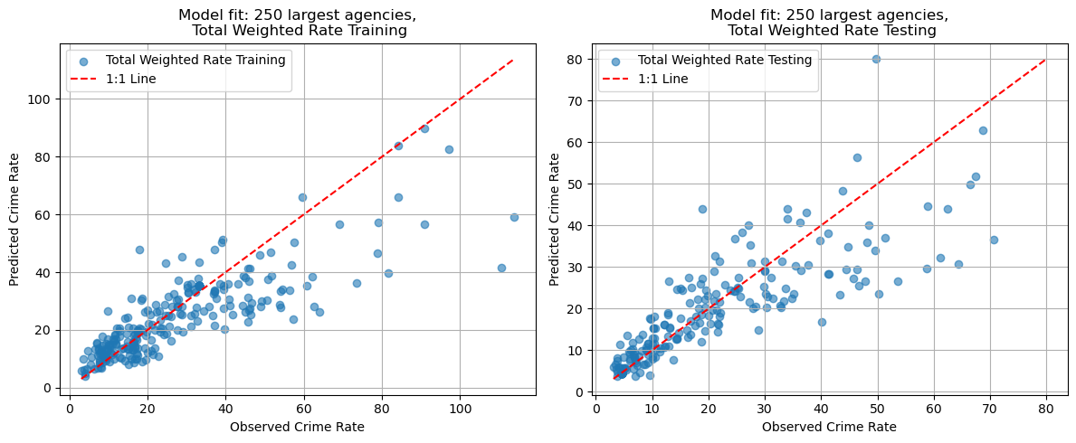
Model Performance & Validation(Pre-Production)
CrimeRisk
Performance Results (continued)

Slide 19
Model Surveillance
CrimeRisk
Model Surveillance Methodology
Amp’d monitoring of annual update data tables
Surveillance is focused on stability of mean values, stability of fill rates, and stability of string lengths year-over-year
Carrier evaluations
The plot at right corresponds to an out-of-sample nationwide validation set based on theft claim history from 423,000 policy years of data by commercial lines carriers.
*Refer to the Model Surveillance Guidance in the Appendix for more details.

Slide 20
Appendix

Slide 21
Model Performance & Validation(Pre-Production)
CrimeRisk
Model Validation Approach
The model was trained on data from 2016 and has been validated with carrier evaluations over the following years.
No formal training/testing split was used in developing the model.
The cases in the total crime index model are weighted by the population of the area. Each observation is weighted in the model according to the method of weighted least squares. The original model training used the US Census Bureau population estimates for July, 2016.
The model was trained on crime reporting from 12,091 US law enforcement agencies made up of over 8 million crime incidents
Performance Results
Model Summary
Model | R | R Square | Adjusted R Square | Std. Error of the Estimate
Total Crime Model | .867 | .751 | .750 | 21.88942
*Refer to the Model Validation Guidance in the Appendix for more details.

